Slide 1
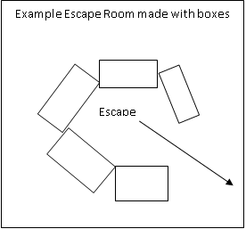
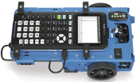
Rover, escape the room!
Texas Instruments
@ticalculators
#tiinnovator
See projects at www.TIstemProjects.com
Contact STEM-team@ti.com with questions
.

Slide 2
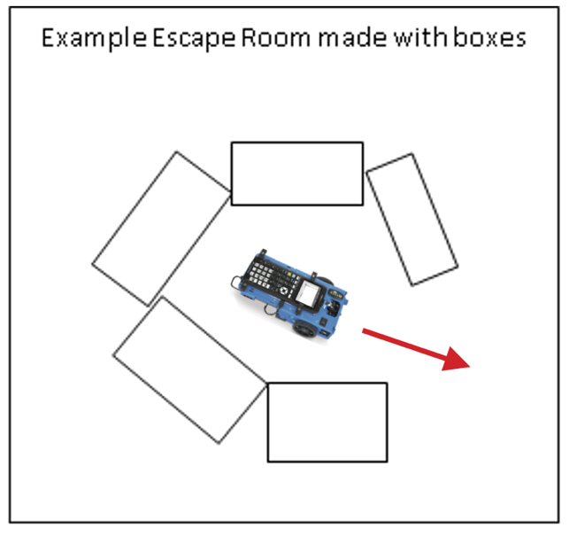
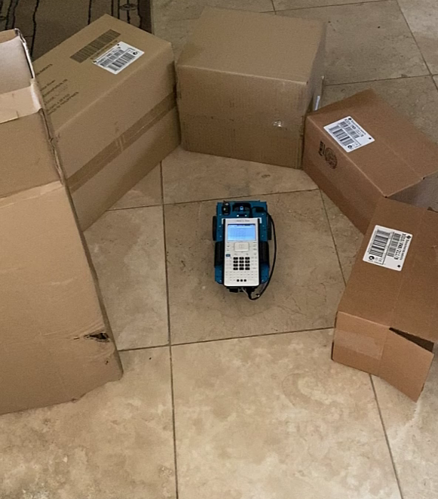
Write a program to help Rover escape
New Program:
Task: Use the ranger to find the opening in a set of boxes and have Rover escape through the opening.
You will need to read the heading for each turn and compare the ranger measurements to determine where the opening is.
Notes:
The number of degrees in each turn here is sort of critical. Too fine of resolution and you might end up heading to the edge of a box, too coarse a resolution and you may miss the opening all together.

Slide 3
Some questions to think about
What will Rover measure?
How will you instruct Rover “look” for a gap?
How will Rover know there is a gap?
Will you have Rover
escape as soon as a gap is detected or
will you look at all the options before deciding where to drive?
How will Rover ”remember” the location of a gap?
How will you instruct Rover to drive through a gap?
Are there patterns in the Rover behavior that your program can adjust for?
What will you do if there is no gap in the wall?

Slide 4
Write your own program
Purpose
What is the purpose of your program?
Name
What is the name of your program?
Inputs
What input values or measurements will you need?
Variables
What variables will you need?
What will you call them?
Calculations and Control Statements
What calculations will you need?
What conditional logic statements will you need?
What loops will you need?
Outputs
What values will you print?
What physical outputs will you make?
Modules: What modules (if any) do you need to import?

Slide 5
Building up to the final challenge

Slide 6
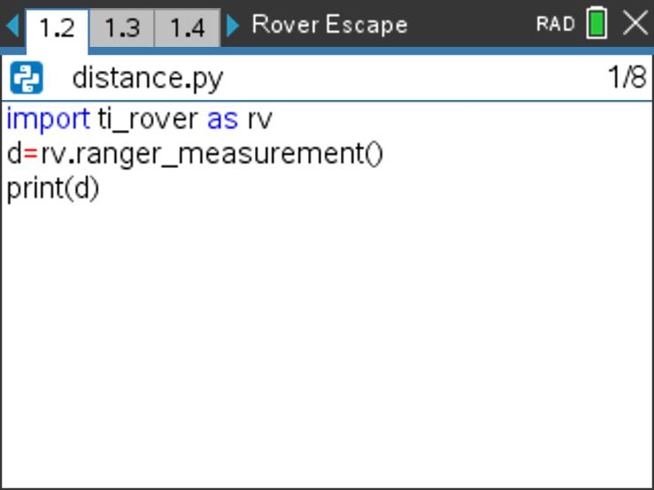
How far away is that?
New Program:
Task: Use the Rover ranger to detect distance to an object and display the distance on the screen
What is the unit of measurement reported by the ranger?
What distance measurements do you see when the Rover is pointed at different places on the enclosure wall?
What distance measurements do you see when Rover is pointed at a gap in the wall?
Find rv.ranger_measurement() on the TI-Rover 3:Inputs menu
Store a value to a variable with “=“
Find print() on the Built-ins 6:I/O menu

Slide 7
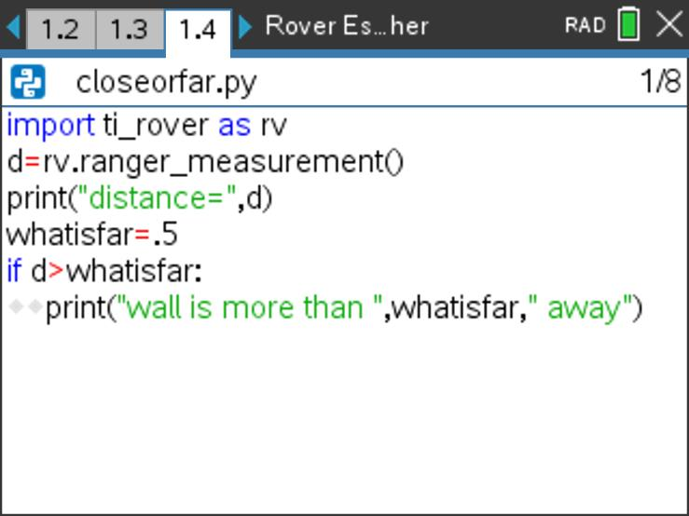
Am I close or far?
New Program:
Task: Use the Rover ranger to detect distance to an object, print the distance.
Have the Rover “decide” if the object is far away. Print an alert message.
Try different values for the whatisfar variable.
Find the if statement [menu] Built-ins 2:Control 1:if..:
If the logic statement at the beginning of the if block is true the program runs the block.
If the logic statement is false, then the block is skipped.
The block starts with a colon and includes all of the indented statements.
The value for the variable whatisfar determines what is considered to be far or close.
The print() function can take multiple inputs separated commas.
Text strings are a set of characters enclosed in quotes. The exact characters are printed.
The quote symbol is entered on the keyboard by [ctrl] [multiple]
A variable name refers to a value. The current value of the variable is printed.

Slide 8
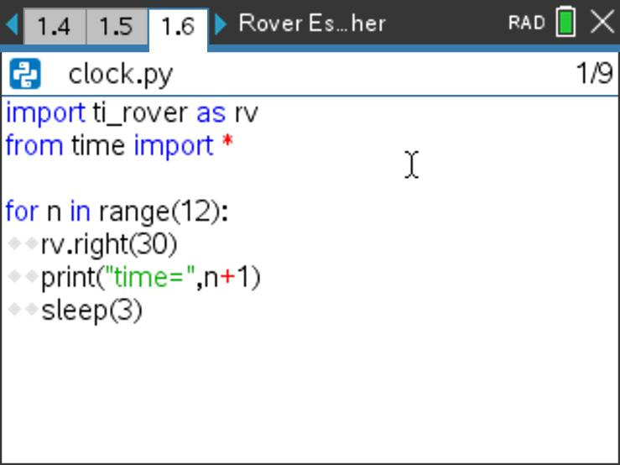
What time is it?
Task: Use Rover to turn the hours of a clock.
Make Rover turn clockwise and stop on every hour of the clock for a 12 hour clock.
Print the current time.
What angle should the Rover turn to stop at twelve hour marks?
Why do we print n+1 for the current hour?
Put the Rover inside your room. Add statements to measure and print distance to the wall at each hour. What patterns do you see in the measurements?
If you finish early, create a way to show a 24 hour clock.
New Program:
Import the time module at [menu] A:More Modules 2:Time to have access to the sleep() function.
Find sleep() on the TI-Rover 7:Commands menu
The sleep() function pauses the program for the number of seconds of the input value in parentheses
Find the for loop statement [menu] Built-ins 2:Control 4:for index in range(size):
A for loop repeats a block of code a known number of times set by the value of the range size.
The loop repeats statements in the indented block beginning with a colon.
The index variable n begins at zero and increases by 1 after each loop.
Looping stops when n is equal to or greater than the loop size.
Notes:
Need to explain finite loops. For loop acts sort of like a while loop with a counting variable. In this case we just specify the number of turns. Students will need to decide the number of degrees to turn for the clock.
For the 24 hour clock, they could indicate AM or PM by the color of the LED and use a conditional.

Slide 9
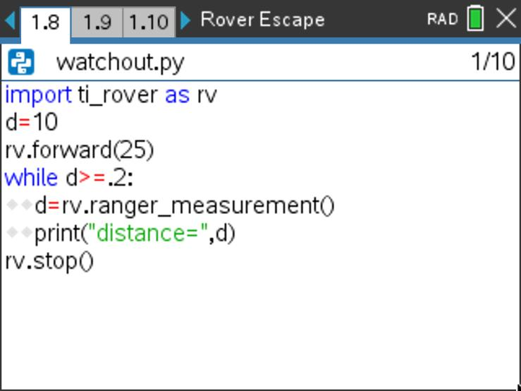
Watch Out!!!
New Program:
Task: Drive Rover at an object and stop prior to the collision.
Use the ranger to detect when Rover is within 20 cm (.2 meters) of an obstacle and stop.
Try different values for the stop distance.
Find the while loop statement [menu] Built-ins 2:Control 8:while..:
A while loop repeats a block of code as long as the initial condition is true. The number of repetitions is unknown.
The loop repeats statements in the indented block beginning with a colon.
The loop continues to repeat as long as the initial statement checks as true.
When the loop stops, the program moves on to the line just after the loop
The print() function can take multiple inputs separated by commas.
Text strings are a set of characters enclosed in quotes. The exact characters are printed.
The quote symbol is entered on the keyboard by [ctrl] [multiple]
A variable name refers to a value. The current value of the variable is printed.

Slide 10
final challenge

Slide 11
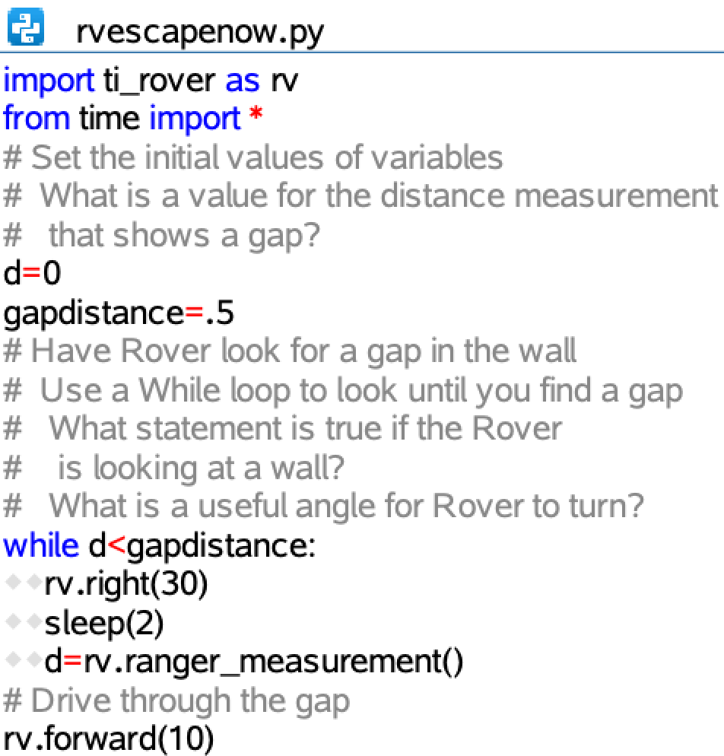
Escape now
New Program:
Task: Use the Rover ranger to detect a gap in the wall and drive through it.
What is the distance measurement when Rover is pointed at a gap in the wall.
Are there patterns in the Rover behavior that your program can adjust for?
How would you modify your program to handle the situation when there is no gap?

Slide 12
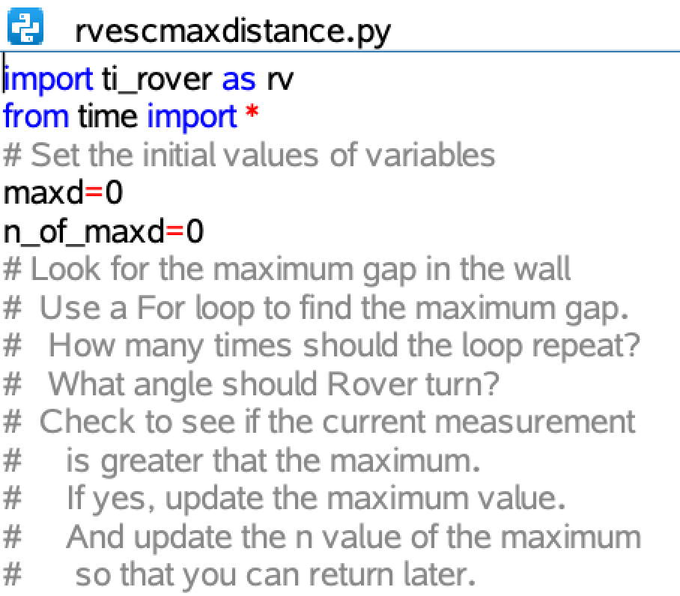
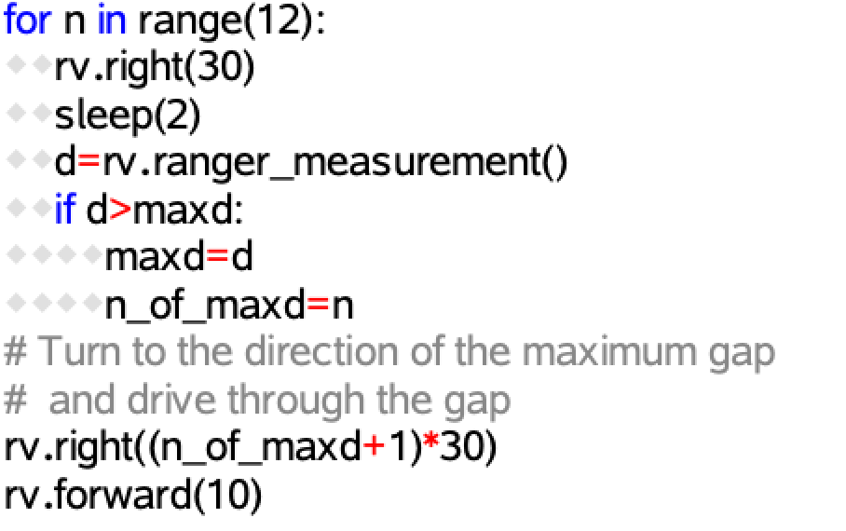
Drive through the maximum gap
New Program:
Task: Use the Rover ranger to detect the maximum gap in the wall and drive through it.
Are there patterns in the Rover behavior that your program can adjust for?
How would you modify your program to handle the situation when there is no gap?

Slide 13
final challenge Examples

Slide 14
Escape now
New Program:
Task: Use the Rover ranger to detect a gap in the wall and drive through it.
What is the distance measurement when Rover is pointed at a gap in the wall.
Are there patterns in the Rover behavior that your program can adjust for?
How would you modify your program to handle the situation when there is no gap?

Slide 15
Drive through the maximum gap
New Program:
Task: Use the Rover ranger to detect the maximum gap in the wall and drive through it.
Are there patterns in the Rover behavior that your program can adjust for?
How would you modify your program to handle the situation when there is no gap?

