Slide 1
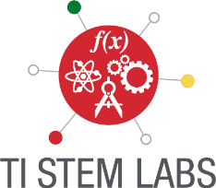
The Power of Realization
Sharing Inspiration 2019

Slide 2
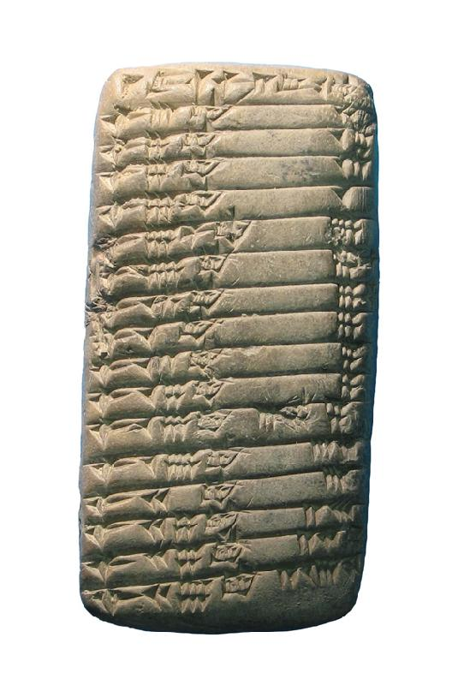
We have come a long way
From
Notes:
From ancient Sumer 2000 BC we have records on clay tablets. Scribes inserted marks with a wooden stylus and used their own sexagecimal numbering system, but had to wait 2000 years before the first calculating machine appeared. The storage medium is non-erasable!

Slide 3
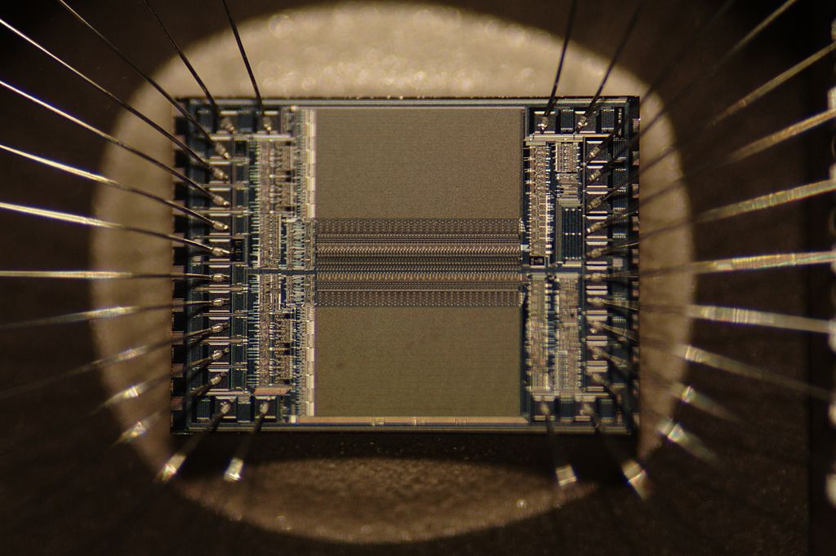
To
Notes:
To the present day. Here the recording device is an EPROM, probably 4 Mbytes. The purpose is the same as the ancient Sumer tablet but the technology has changed and so has the numbering system which is hexadecimal. This is an integrated circuit invented by Jack Kilby of Texas Instruments.

Slide 4
That was the Tease, now the Entertainment
via
Notes:
Along the way from clay tablets to semiconductor storage devices calculators made their appearance and evolved over the ages. Here is just a selection of such devices

Slide 5
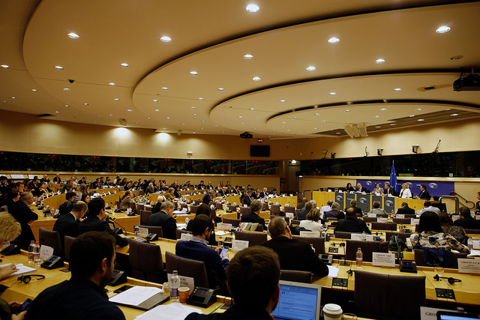
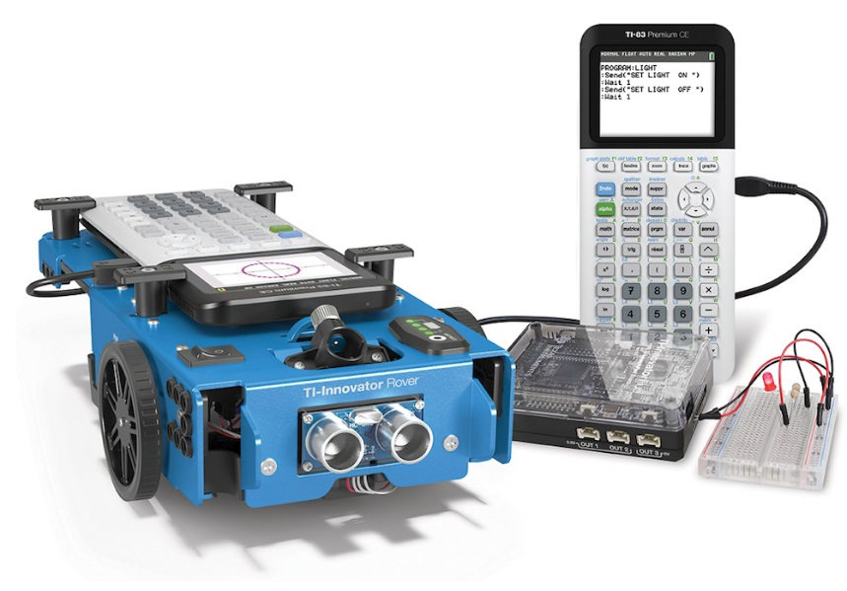

From Policy makers to practitioners
Notes:
In this conference we have moved from the policy makers day to the practitioners programme. About 100 people met in the Committee of the Regions rooms in the Jacques Delors building and worked with business and government leaders on educational issues. We educators have focused on how to motivate students through the latest technology from Texas Instruments, graphing calculators, the TI Innovator Hub and the TI Rover.

Slide 6
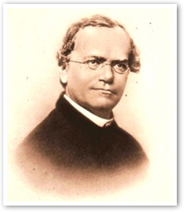
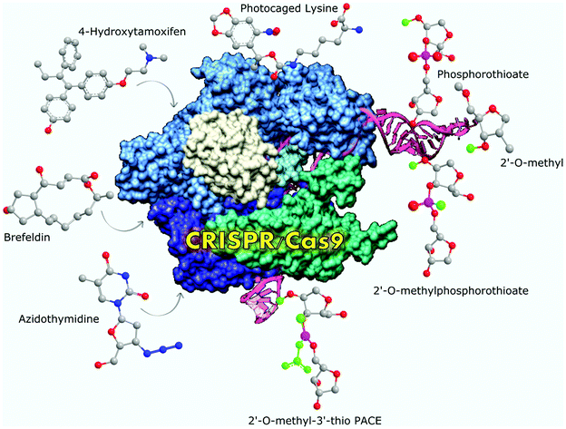
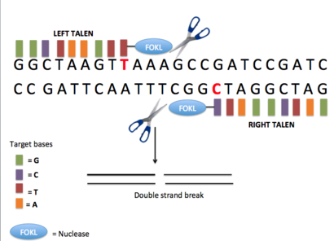
From Mendelism to Genomic Engineering
Notes:
The science content we use has evolved over the last hundred years. Gregor Mendel’s work has led to genomic engineering and the study of protein folding,

Slide 7
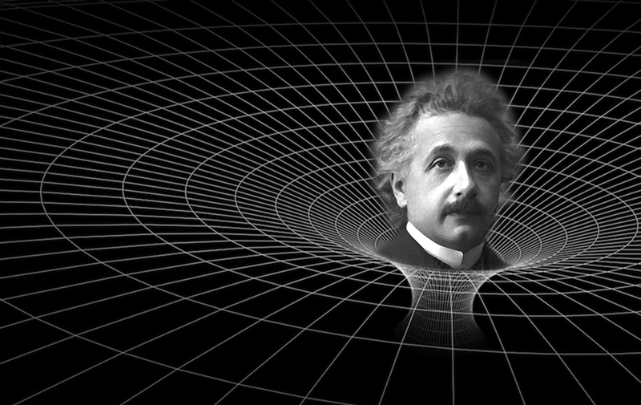
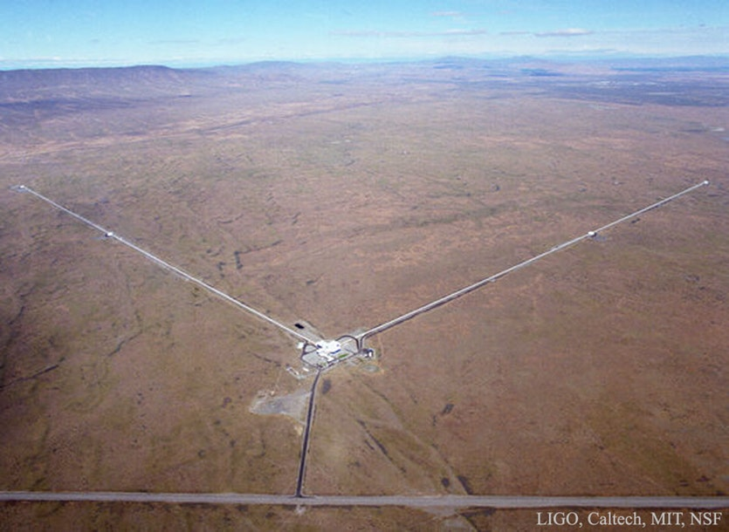
From General Relativity to gravity telescopes
Notes:
While Einstein’s work on General Relativity has resulted in the construction of telescopes capable of detecting ripples in space time of the order of atomic diameters. These ripples from the collisions of Black Holes have reached us from the other side of the Universe and have resulted in a completely new spectrum for observing physical phenomena.

Slide 8
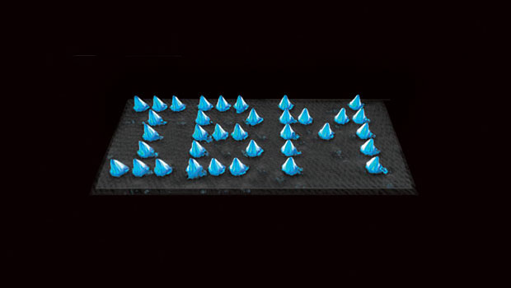
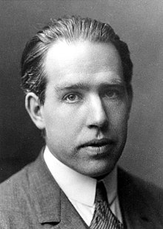
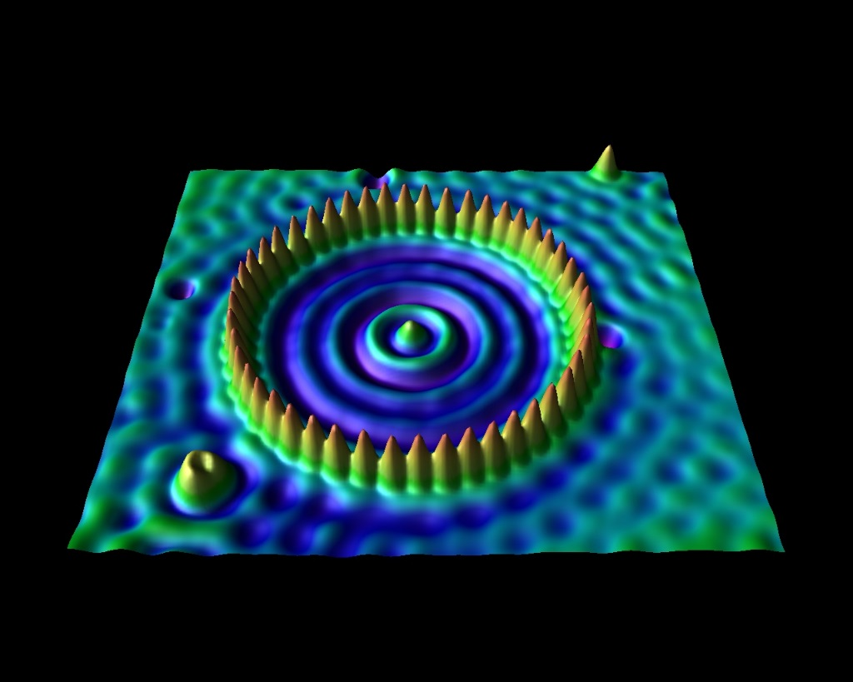
From quantum mechanics to nanotechnology
Notes:
Nanotechnology has grown out of the labours of the early quantum mechanicists such as Neils Bohr. Now we can manipulate matter at the individual atom level and take images of the results. Genomic engineering, gravity wave telescopes and nanotechnology are the fusion of skills across the STEM subjects and could not possibly have arisen from the work of individuals in any one discipline

Slide 9
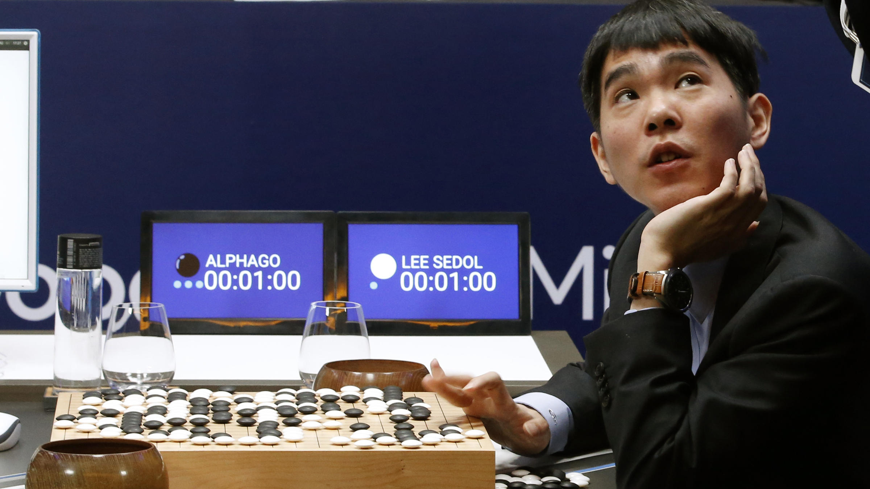
For the first time in human history we can now talk to machines
Notes:
And finally we see here the world’s greatest Go player, Lee Sedol, looking up at the score board in disbelief as Google’s computer AlphaGo succeeds in beating him in the second game of a series of five. AlphaGo went on the beat Lee in the next three games after apparently learning where Lee’s weak spots were in the first game. We are on the edge of Artificial Intelligence but in any case we now live in a world where we can talk to machines in many languages.

Slide 10
Tease
Entertain
Amaze
Challenge
Help
So amazement is over, now for the challenge…
Notes:
Having been teased entertained and amazed the next step is the Challenge. My own philosophy of teaching is that teachers should always seek to tease entertain amaze challenge and then help students, in that order, in every lesson. Success in motivating students to learn is assured if this recipe is followed, no matter what style of teaching is adopted.

Slide 11
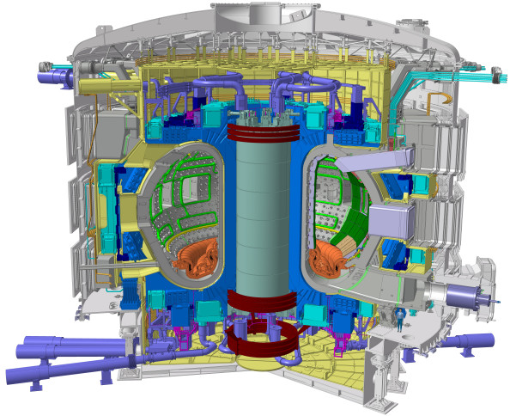
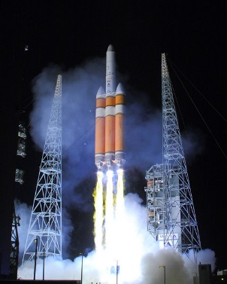
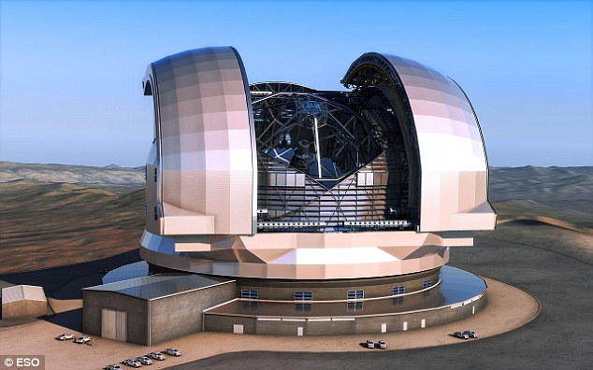
The Big Challenges
Notes:
The extremely large telescope being built by Europe in Chile, the International thermonuclear experimental reactor at Cadarache and the Mission to Mars which which incorporates European mission critical hardware and software need input from engineers, physicsts mathematicians chemists chemical, structural and mechanical engineers.. All of these vast engineering challenges require STEM skills in abundance, skills drawn from the human activities of science mathematics technology and engineering.

Slide 12
The Big Challenges
Genomics
Water
Food
Air
Climate Change
Notes:
Problems much closer to home require the expertise of biologists, horticulturalists, nutritionists, ethicists and environmental engineers. None of these problems will be solved by experts in any one human activity, we need people who are STEM literate and able to move seamlessly across subject divisions.

Slide 13
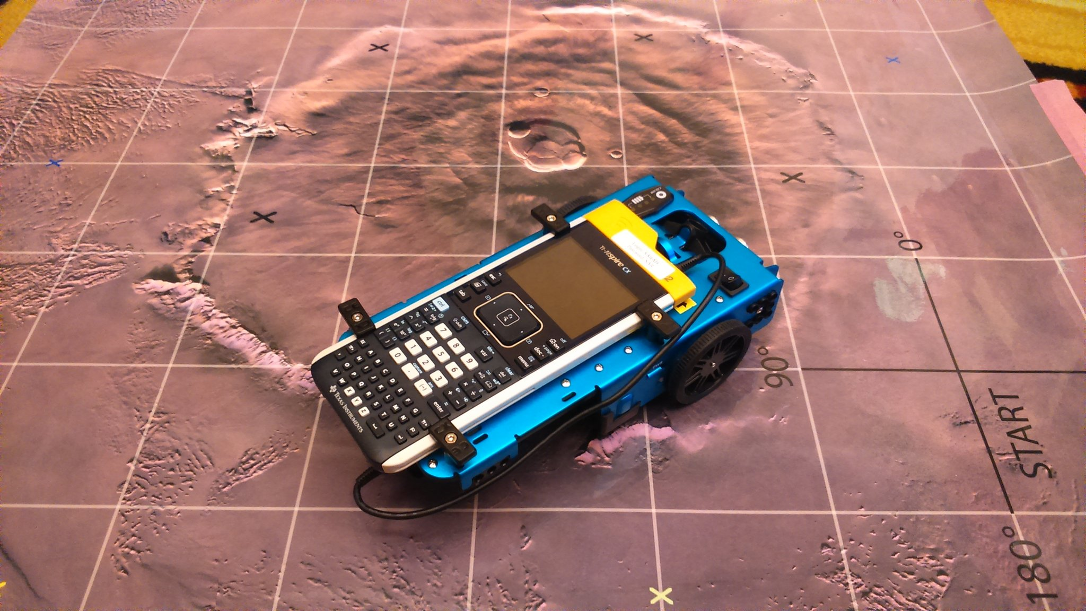
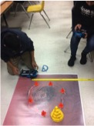

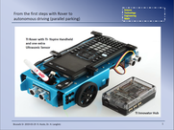
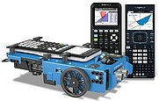
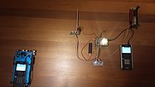
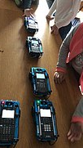
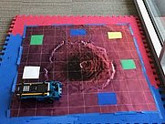

The Challenge, using Rover in the classroom.
Notes:
You all rose to the challenge of finding ways to use the TI Rover to encourage your students to learn. Autonomous parking, motion operated wheelchairs, Mars missions, random walks and many other ideas were in abundance

Slide 14
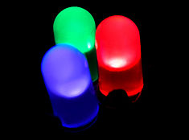
So here is my Challenge.
The LED is now ubiquitous.
It appears in science curricula as an efficient lighting device
No suggestion is made that children should learn how it works
It is a quantum mechanical device
It is therefore an opportunity to introduce children to quantum mechanics
Notes:
My personal challenge to you is to consider how we might develop a pedagogy of how the LED works. The device is after all ubiquitous and could serve as the platform for allowing students a glimpse of quantum mechanics, a theory now more than 100 years old. Surely young people have an entitlement to understand at their own cognitive level how this now familiar light source works.

Slide 15
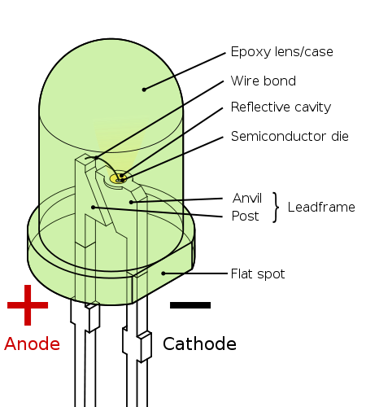

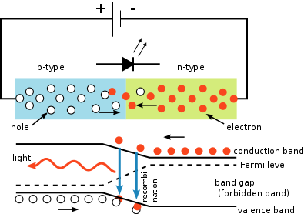
LEDs
Notes:
It would mean translating the theory into something accessible and something which makes sense. It may not require much more than using what they already know in terms of the attraction and repulsion of electric charges. We are missing an opportunity if we do not capitalise on this device which incidentally is an example of another Texas Instruments invention, 1962.

Slide 16
…what next
Consciousness and AI
Understanding the Copenhagen Principle and quantum physics and chemistry
SQUIDS and quantum computers and cryptography
Black holes, dark energy and dark matter
Nobody knows, hence why do we teach the way we do?
Notes:
Maybe understanding consciousness will lead to AI? Will understanding the Copenhagen Principle lead to new advances in quantum physics and chemistry? Will we succeed in creating quantum computers using superconducting quantum interference devices? Will we ever know anything about the inside of a Black Hole can any light be shed on dark energy and dark matter?

Slide 17
…so how do we teach?
Interactive white boards
largely used as a white board
not dissimilar to an old blackboard!
In classrooms of 20-30 children
text books and exercise books
Laptops occasionally
We follow subject curricula
tightly focused on examination requirements
with little room left for the imagination
Notes:
Our teaching methods have not really changed so much in 100 years. We use boards in front of big classes and attempt to get them to learn the material; necessary to pass exams. Many teachers have had to listen to the question “is this in the exam?”. Skillful teachers ignore the jibe and succeed in igniting the imaginations of their students despite the curriculum. But it is you who are the experts…we are the teachers teaching with technology and it is we who can promote and lead change in our profession.

Slide 18
But help is at hand!
Notes:
So, keeping in mind the comments and suggestions made two years ago here in Brussels, concerning a more student centred approach to our activities, Texas Instruments has set up a new network within T cubed…

Slide 19
Help, the final brick in the wall of TEACH
Notes:
The TI STEM laboratory Schools. We had our first meeting in Bratislava last year and I consider this, the 2019 Sharing Inspiration conference, the second full meeting of that network. Many of the workshops, discussion groups, playground presentations and paper presentations have been given by teachers from the TI STEM lab schools and so the challenge to spread what we believe is good practice in STEM education to your neighbours in whatever country you live in rests with you!

Slide 20
54686520456E64
Notes:
With apologies, you of course are not machines and this is hex code, I meant to say ….

Slide 21
The End
Notes:
The end.

